Slide 1



Weekly Meeting
Liri Chen, Shuo Lin, Wenqi Sun, Zhexin Wang, Zixiao Zhang

Slide 2
Aligned Timeline
Time | Milestone | Status
Oct 3 - Oct 17 | Baseline, metrics | Done
Oct 18 - Oct 31 | Data Retrieval Optimization UI Design | Done
Nov 1 - Nov 21 | Prototype & demo(Search w/o GPT + WebApp) Data Retrieval Integration & Optimization | In Progress
Nov 22 - Nov 28 | Backend API & UI design
Nov 29 - Dec 16 | Final Presentation

Slide 3
Responsibilities in the second part
Responsibilities | People
User Interface | Zixiao & Wenqi
Searching | Shuo & Zhexin
Model Optimization(table) | Liri
Model Optimization(image & caption) | Wenqi
Project Manager | Zhexin

Slide 4
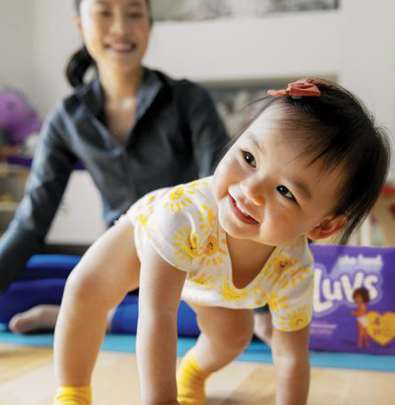
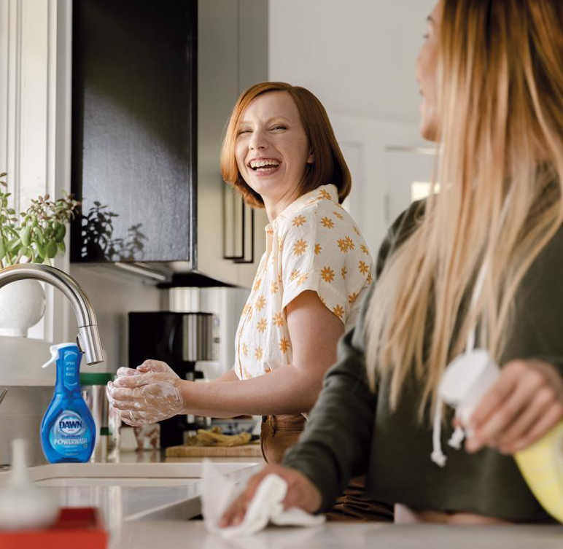
Image Retrieval Result - Top-k ✅
A joyful baby in a yellow outfit playfully crawls on a blue mat with a smiling adult watching over her in a home setting.

Slide 5

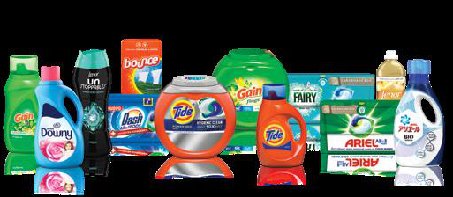
Image Retrieval Result - Top-k ✅
packages of Tide Power Pods and Ariel All-in-1 Pods laundry detergents

Slide 6
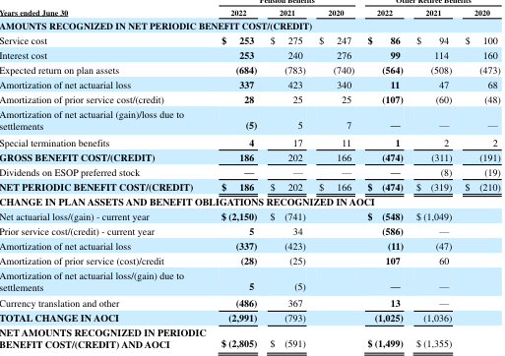
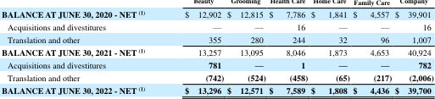
Table Retrieval Result - Top-k ❌
a comparison of key financial metrics as a percentage of net sales for Procter & Gamble between 2012 and 2011

Slide 7
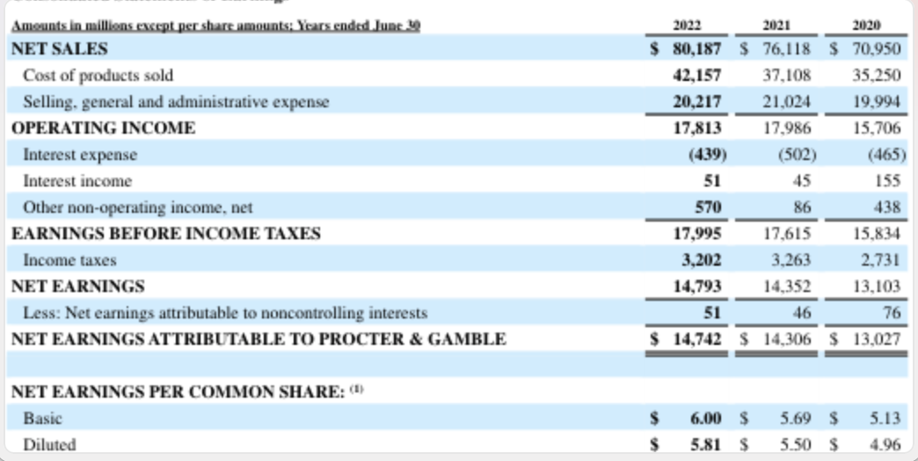
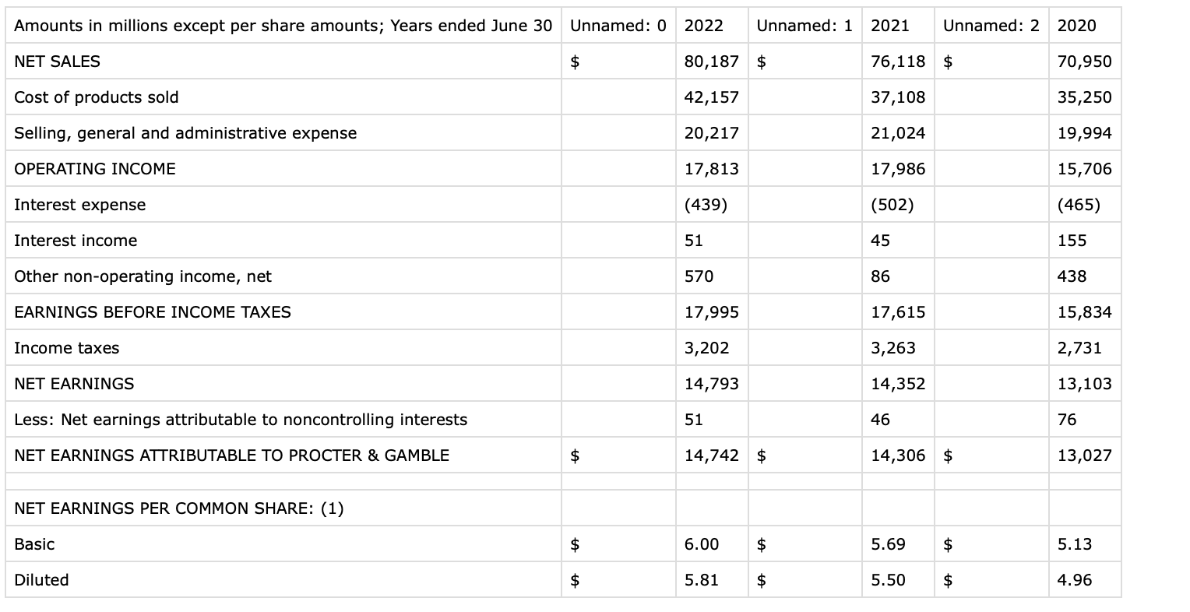
Table Retrieval Results - Update

Slide 8
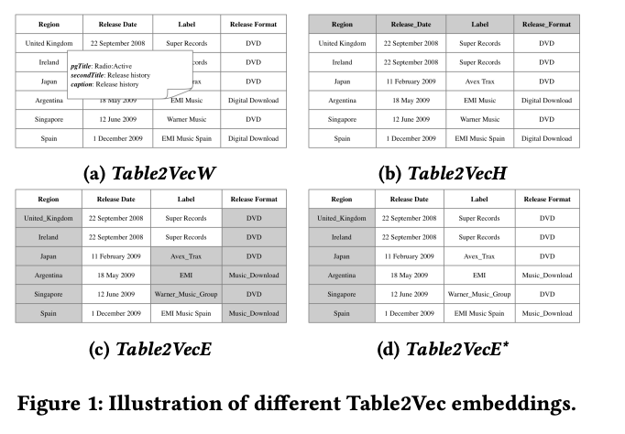
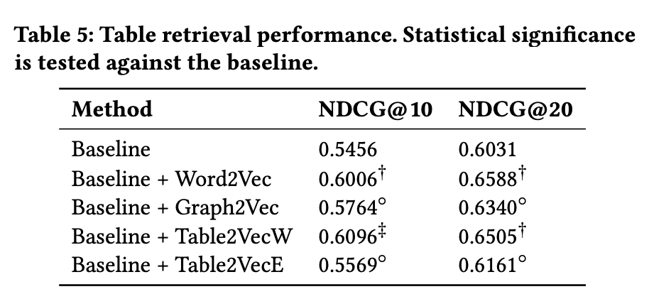
Table Embeddings
TabNet (https://arxiv.org/abs/1908.07442)
Table2Vec (https://arxiv.org/pdf/1906.00041.pdf) ✅
AutoEncoders (https://walkwithfastai.com/tab.ae)

Slide 9
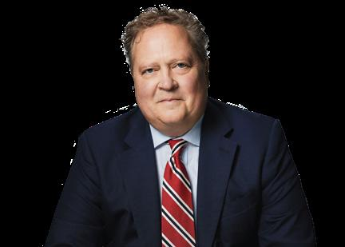
Caption Retrieval Result
"2_image_0_Im0.jpg": [
"JON R. MOELLER",
"headwinds, and continued strong cash return to ",
"after-tax profit\u2009\u2014\u2009executing our integrated strategies "
],
(Will get rid of these unicode symbols later)

Slide 10
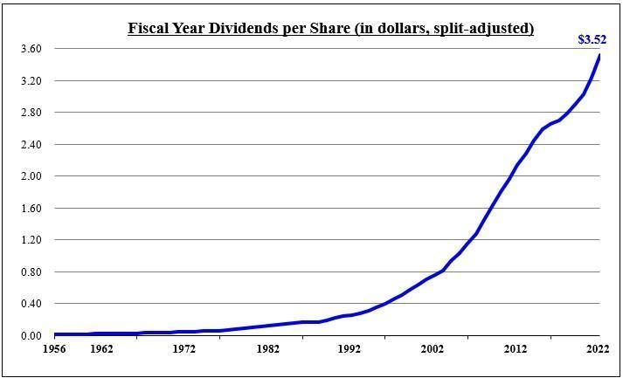
Caption Retrieval Result
"22_image_0_Im0.jpg": [
"consecutive years since 1956. Over the past ten years, the dividend has incr", (truncated to 77 characters)
"Dividends per share $ 0.01 $ 0.02 $ 0.05 $ 0.13 $ 0.26 $ 0.76 $ 2.14 $ 3.52 ",
"Nevertheless , as in the past, further dividends will be considered after rev"
],

Slide 11
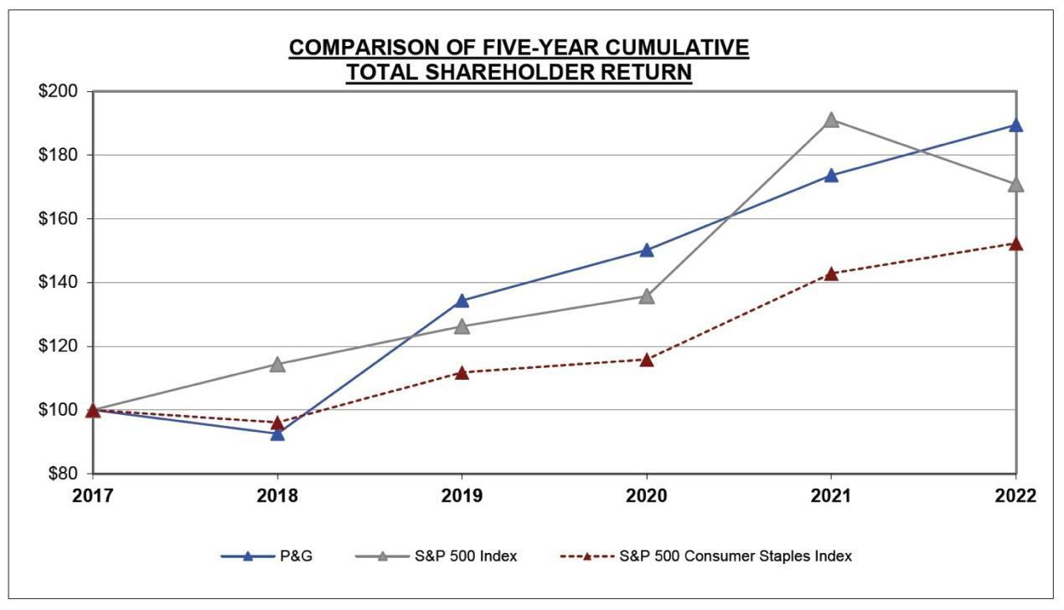
Caption Retrieval Result
"23_image_0_Im0.jpg": [
"2022, against the cumulative total return of the S&P 500 Stock Index (broad m",
"The following graph compares the cumulative total return of P&G\u2019s common stoc",
"S&P 500 Consumer Staples Index 100 96 112 116 143 152 "
],

Slide 12
Current problems with caption retrieval
Due to limitation of the current model (CLIP), a sentence can not exceed 77 characters, causing truncated sentences.
The model will match some unrelated captions even if the image is only for cosmetics.
Need to figure out a smart way to split paragraphs based on semantic meanings

Slide 13
Discussions
When are we expected to have the access to Azure computing platform?
Maybe need some time to play around with it
Some deep learning packages require several setup steps, which may cause troubles in cloud environment

